Slide 1
Design for Testability Theory and Practice
Lecture 11: BIST
Definition of BIST
Pattern generator
  LFSR
Response analyzer
  MISR
  Aliasing probability
BIST architectures
  Test per scan
  Test per clock
  Circular self-test
  Memory BIST
Summary

Slide 2
Define Built-In Self-Test
Implement the function of automatic test equipment (ATE) on circuit under test (CUT).
Hardware added to CUT:
    Pattern generation (PG)
    Response analysis (RA)
    Test controller
CK
PG
Stored
Test
Patterns
Pin
Electronics
CUT
Test control logic
CUT
Test control HW/SW
BIST
Enable
RA
Stored
responses
Comparator
hardware
ATE
Go/No-go
signature

Slide 3
Pattern Generator (PG)
RAM or ROM with stored deterministic patterns
Counter
Pseudorandom pattern generator
  Feedback shift register
  Cellular automata

Slide 4
Pseudorandom Integers
X_{k} = X_{k-1} + 3 (modulo 8)
X_{k} = X_{k-1} + 2 (modulo 8)
0
0
7
1
7
1
6
2
Start
6
2
Start
+3
+2
5
3
5
3
4
4
Sequence: 2, 5, 0, 3, 6, 1, 4, 7, 2 . . .
Sequence: 2, 4, 6, 0, 2 . . .
Maximum length sequence: 3 and 8 are relative primes.

Slide 5
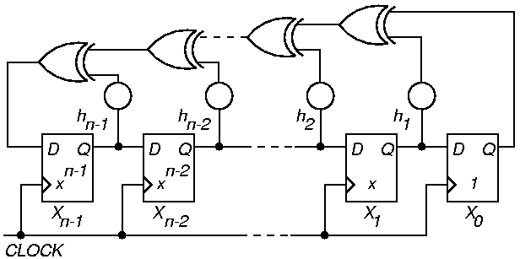
Pseudo-Random Pattern Generation
Standard Linear Feedback Shift Register (LFSR)
  Produces patterns algorithmically – repeatable
  Has most of desirable random # properties
May not cover all 2^{n} input combinations
Long sequences needed for good fault coverage
either h_{i} = 0, i.e., XOR is deleted
or h_{i} = X_{i}
Initial state (seed): X₀, X₁, . . . , X_{n-1}
must not be 0, 0, . . . , 0

Slide 6
Matrix Equation for Standard LFSR
X₀ (t + 1)
X₁ (t + 1)
.
.
.
X_{n-3} (t + 1)
X_{n-2} (t + 1)
X_{n-1} (t + 1)
0
0
.
.
.
0
0
1
1
0
.
.
.
0
0
h₁
0
1
.
.
.
0
0
h₂
…
…
…
…
…
0
0
.
.
.
1
0
h_{n-2}
0
0
.
.
.
0
1
h_{n-1}
X₀ (t)
X₁ (t)
.
.
.
X_{n-3} (t)
X_{n-2} (t)
X_{n-1} (t)
=
X (t + 1) = T_{s} X (t) (T_{s} is companion matrix)

Slide 7
LFSR Implements a Galois Field
Galois field (mathematical system):
  Multiplication by X same as right shift of LFSR
  Addition operator is XOR ( )
T_{s} companion matrix:
  1st column 0, except nth element which is always 1 (X₀ always feeds back)
  Rest of row n – feedback coefficients h_{i}
  Remaining identity matrix means a right shift
Near-exhaustive (maximal length) LFSR
  Cycles through 2^{n} – 1 states (excluding all-0)

Slide 8
LFSR Properties
Must not initialize to all 0’s – hangs
If X is initial state, LFSR progresses through states
X, T_{s} X, T_{s}² X, T_{s}³ X, …
Matrix period:
  Smallest k such that T_{s}^{k} = I
  k = LFSR cycle length
  Maximum length k = 2^{n}-1, when feedback (characteristic) polynomial is primitive
  Example: 1 + X+ X³
Characteristic polynomial:
  1 + h₁ x + h₂ X² + … + h_{n-1} X^{n-1} + X^{n}

Slide 9
LFSR: 1 + X + X³
RESET
100
001
000
110
010
D Q
X²
D Q
X¹
D Q
X⁰
111
101
CK
011
RESET
X₂
X₁
X₀
Test of primitiveness: Characteristic polynomial of degree n
must divide 1 + X^{q} for q = n, but not for q < n

Slide 10
LFSR as Response Analyzer
Use cyclic redundancy check code (CRCC) generator (LFSR) for response compacter
Treat data bits from circuit POs to be compacted as a decreasing order coefficient polynomial
CRCC divides the PO polynomial by its characteristic polynomial
  Leaves remainder of division in LFSR
  Must initialize LFSR to seed value (usually 0) before testing
After testing – compare signature in LFSR to precomputed signature of fault-free circuit

Slide 11
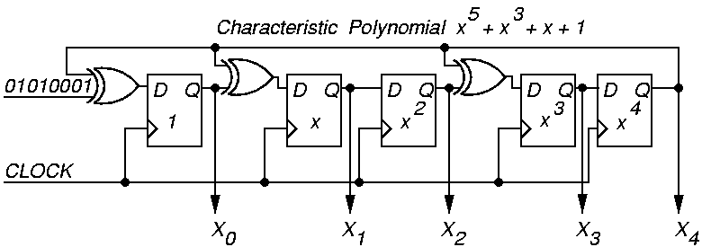
Example Modular LFSR Response Analyzer
LFSR seed is “00000”

Slide 12
Signature by Logic Simulation
Input bits
Initial State
1
0
0
0
1
0
1
0
X⁰
0
1
0
0
0
1
1
1
1
X¹
0
0
1
0
0
0
0
1
0
X²
0
0
0
1
0
0
0
0
1
X³
0
0
0
0
1
0
1
0
1
X⁴
0
0
0
0
0
1
0
1
0
Signature

Slide 13
Signature by Polynomial Division
Input bit stream: 0 1 0 1 0 0 0 1
0 ∙ X⁰ + 1 ∙ X¹ + 0 ∙ X² + 1 ∙ X³ + 0 ∙ X⁴ + 0 ∙ X⁵ + 0 ∙ X⁶ + 1 ∙ X⁷
X²
X⁷
X⁷
+ 1
+ X⁵
X⁵
X⁵
X⁵ + X³ + X + 1
Char. polynomial
+ X³
+ X³
+ X³
X³
+ X
+ X
+ X
+ X²
+ X²
+ X²
+ 1
+ 1
remainder
Signature: X⁰ X¹ X² X³ X⁴ = 1 0 1 1 0

Slide 14
Multiple-Input Signature Register (MISR)
Problem with ordinary LFSR response compacter:
  Too much hardware if one of these is put on each primary output (PO)
Solution: MISR – compacts all outputs into one LFSR
  Works because LFSR is linear – obeys superposition principle
  Superimpose all responses in one LFSR – final remainder is XOR sum of remainders of polynomial divisions of each PO by the characteristic polynomial

Slide 15
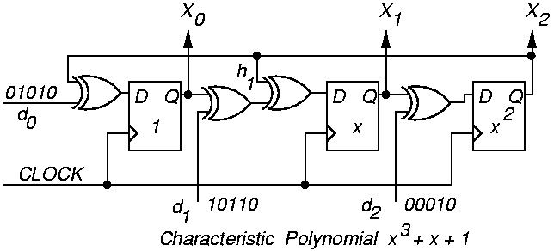
Modular MISR Example
X₀ (t + 1)
X₁ (t + 1)
X₂ (t + 1)
0
1
0
0
0
1
1
1
0
X₀ (t)
X₁ (t)
X₂ (t)
d₀ (t)
d₁ (t)
d₂ (t)
=
+

Slide 16
Aliasing Probability
Aliasing means that faulty signature matches fault-free signature
Aliasing probability ~ 2^{-n}
  where n = length of signature register
  Example 1: n = 4, Aliasing probability = 6.25%
  Example 2: n = 8, Aliasing probability = 0.39%
  Example 3: n = 16, Aliasing probability = 0.0015%
Fault-free
signature
2^{n}-1 faulty
signatures

Slide 17
BIST Architectures
Test per scan
Test per clock
Circular self-test
Memory BIST

Slide 18
Test Per Scan BIST
PG
Scan register
PI and PO
disabled
during test
Comb. logic
Scan register
BIST
Control
logic
BIST
enable
Go/No-go
signature
Comb. logic
Scan register
Comb. logic
RA
Scan register

Slide 19
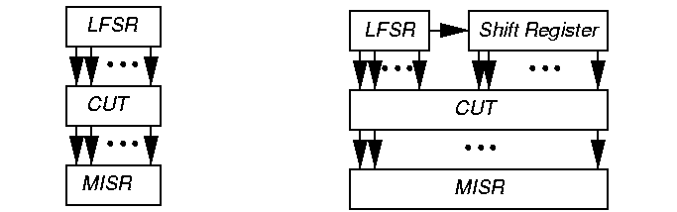
Test per Clock BIST
New fault set tested every clock period
Shortest possible pattern length
  10 million BIST vectors, 200 MHz test / clock
  Test Time = 10,000,000 / 200 x 10⁶ = 0.05 s
  Shorter fault simulation time than test / scan

Slide 20
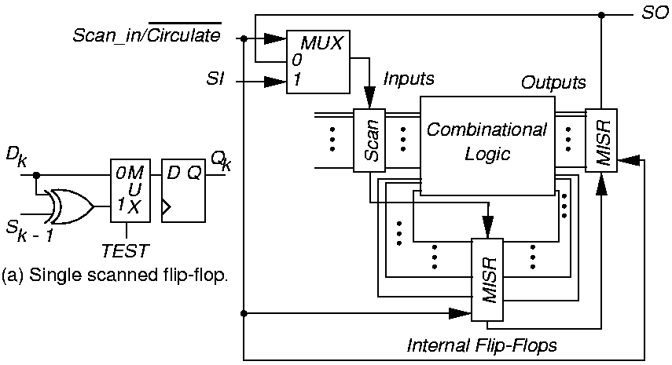
Circular Self Test

Slide 21
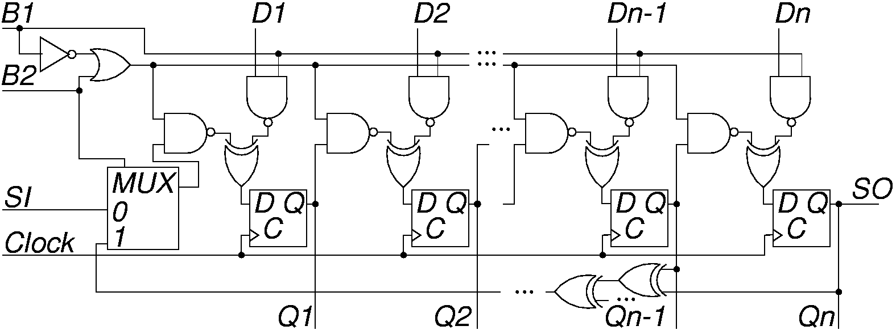
Built-in Logic Block Observer (BILBO)
Combined functionality of D flip-flop, pattern generator, response analyzer, and scan chain
  Reset all FFs to 0 by scanning in zeros

Slide 22
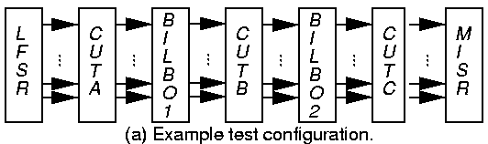
Test per Clock with BILBO
SI – Scan In
SO – Scan Out
Characteristic polynomial: 1 + x + … + x^{n}
CUTs A and C: BILBO1 is MISR, BILBO2 is LFSR
CUT B: BILBO1 is LFSR, BILBO2 is MISR

Slide 23
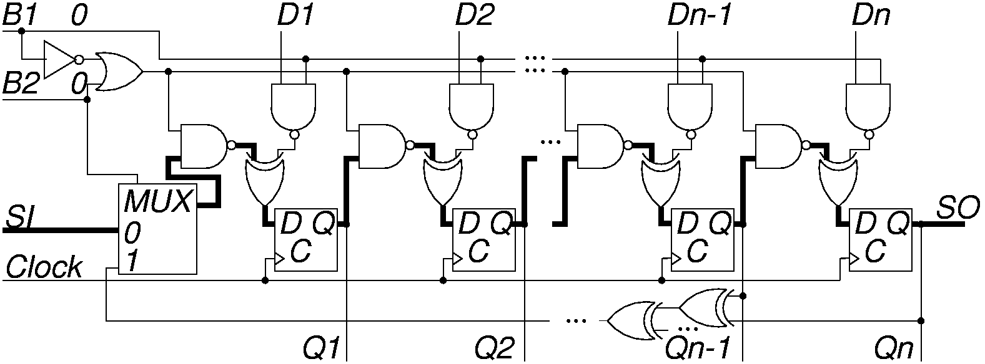
BILBO Serial Scan Mode
B1 B2 = “00”
Dark lines show enabled data paths

Slide 24
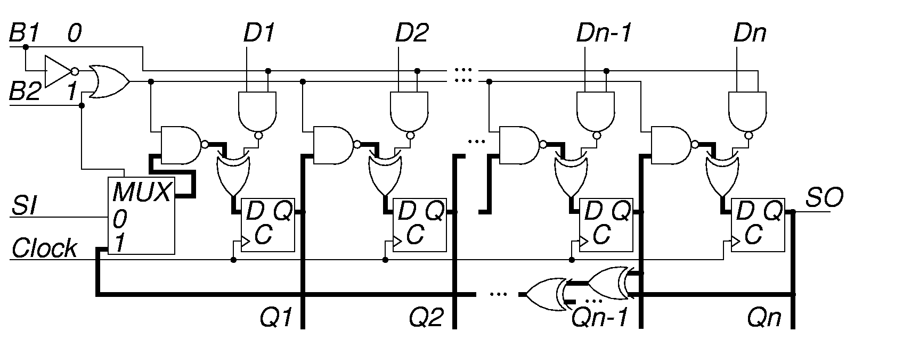
BILBO LFSR Pattern Generator Mode
B1 B2 = “01”

Slide 25
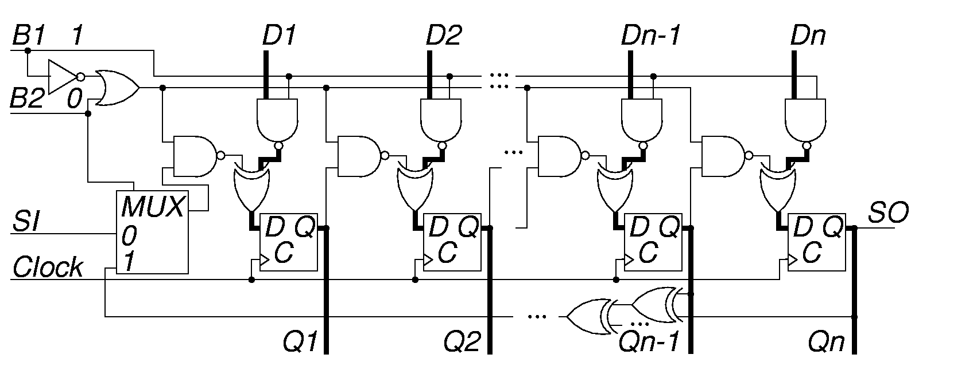
BILBO in DFF (Normal) Mode
B1 B2 = “10”

Slide 26
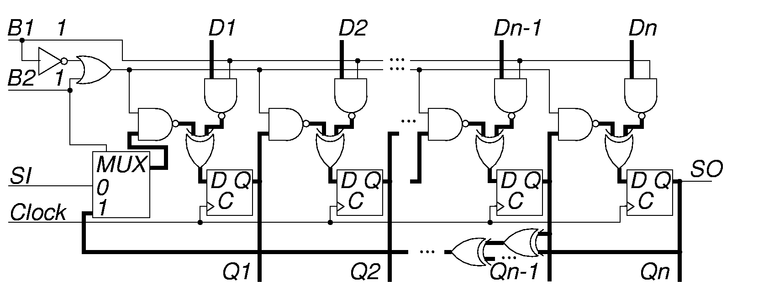
BILBO in MISR Mode
B1 B2 = “11”

Slide 27
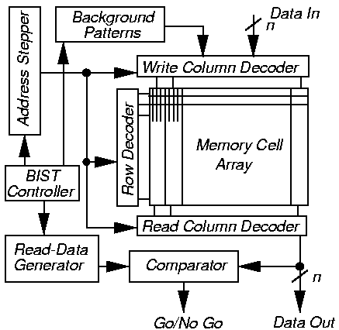
Memory BIST

Slide 28
Summary
LFSR pattern generator and MISR response analyzer – preferred BIST methods
BIST has overheads: test controller, extra circuit delay, primary input MUX, pattern generator, response compacter, DFT to initialize circuit and test the test hardware
BIST benefits:
  At-speed testing for delay and stuck-at faults
  Drastic ATE cost reduction
  Field test capability
  Faster diagnosis during system test
  Less effort in the design of testing process
  Shorter test application times

